Slide 1
LexMex 2017 TRENDS AND CHALLENGES. COMMERCIAL, ADMINISTRATIVE LITIGATION AND ARBITRATION.
CARLOS MALPICA

Slide 2
Trends 2016
North American Free Trade Agreement NAFTA (1994).
a) North American Free Trade Agreement, currently ongoing negotiations.
b) Other FTA’s with 46 Countries.
Main reforms before Democratic Breakthrough (BDB).
a) Judiciary reform (1994). Appointment of Justices by the Executive Branch/Senate.
b) Judiciary Council (1994). Chief Justice, MSCJ, Senate, Executive Branch.
c) Banco de México (1994). Central Bank, Executive Branch, Senate.
d) Electoral Reform (1996). Autonomy Electoral Institute/Specialized Courts (Supreme Court/Senate)
2000 Democratic Breakthrough (DB).
a) Democratic transition, first change in Ruling Party since 1929.
b) Congressional impasse for structural reforms (Fox Tax/Energy-Antitrust Calderon).

Slide 3
Main reforms after Democratic Breakthrough (ADB).
a) Alternative Dispute Resolution (2008-2011). Uncitral Model Law since 1993, constitutional amendments to provide for alternative methods of dispute resolution 2008/Special summary proceeding for the execution of awards.
b) Collective/Class Actions (2011-2012). Either Diffuse (i.e. environmental), Strict Sense (i.e. product liability, consumers); Individual (30 persons or more with the same contractual right).
Pacto Por Mexico, Actual Structural Reforms (2012-).
a) Telecomm Antitrust (2013). Constitutional Autonomy of the Federal Telecommunication Institute (IFT) and Federal Antitrust Commission (7 members Executive Branch/Senate).
b) Energy (2013).Constitutional reform to facilitate private investment in petroleum exploration, extraction, refining, petrochemical, transportation and storage. Arbitration admitted, excluding administrative rescission and creation of the Mexican Environmental Protection Agency other autonomous regulatory entities for the sector (Energy Regulatory Commission/National Hydrocarbons Commission). All autonomous (7 members Executive Branch/Senate).
c) Education Reform (2013). Model, Professionalization, Evaluation, Access and Autonomy.
d) Anti-Corruption System (2016). System created by several committees coordinated by a mix of a Citizen Committee, Federal Auditor, Specialized Prosecutor, Public Servant Ministry, President of the Public Access Institute, President of the Administrative Tribunal (specialized courts).
e) Criminal liability/damage repair for Corporations (2016). Due supervision, diligence and public interest.

Slide 4
2017 Trends
Anti Corruption Practices, Administrative Responsibilities (2016-2017)
a) Requires public officers to provide information on assets/conflicts.
b) Strengthens faculties of the Federal Audit Office.
c) Creates Specialized Courts.
d) Creates Specialized Prosecution/Supervision.
e) Appointments (Executive/Senate).
f) Responsibility of private companies and individuals.
Labour Reform (2017).
a) Specialized Federal and State Courts, instead of executive branch arbitration boards.
b) Creation of Mediation Centre's (Executive/Senate).
c) Free private and secret vote for election of representatives, alternate solution of conflicts
licit/illicit strikes, public interest, syndicate.

Slide 5
Mexican Judicial System vs Latin America.
Arbitration in Mexico.
Telecomm War, IFT Autonomy.
Energy, Reform Implementation, love-hate relationship.
Odebrecht a Landmark Case for Latin America.
Law enforcement.

Slide 6
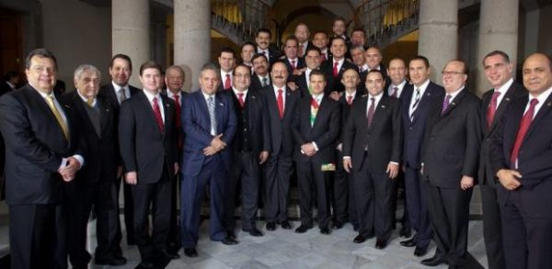
In Jail. Javier Duarte and Flavino Ríos, Veracruz; Mario Villanueva, Quintana Roo; Andrés Granier, Tabasco; Jesús Reyna, Michoacán; and Guillermo Padrés, Sonora.
Detained ongoing extradition proceedings. Tomas Yarrington, Tamaulipas, and Roberto Borge, Quintana Roo.
Ongoing criminal proceedings. Armando Reynoso, Aguascalientes, Rodrigo Medina, Nuevo León.
Under investigation. Fidel Herrera, Veracruz, Gabino Cue, Oaxaca.
Under investigation by foreign countries. Humberto Moreira, Coahuila and Eugenio Hernández, Tamaulipas.
Fugitives. Jorge Juan Torres, Coahuila, César Duarte, Chihuahua

